Slide 1
Healthcare Deserts in the DMV
Ms Emily Reynolds
Mr. Richie Pherson
Mr. Mike Marshall
Mr. Vibhanshu Shekhar

Slide 2
Motivation & Summary Slide
We are interested in how economic conditions in specific geographic areas affect access to healthcare in the Washington, DC area.
What is the likelihood that more doctors are located in more populated areas?
Would hospital facilities be located more within higher income or lower income areas?
Is the unemployment rate higher in lower income areas?
Does per capita income influence the percentage of individuals possess healthcare insurance?
We found that

Slide 3
Questions & Data
Question #1: What is the likelihood that more doctors would be located in higher populated areas?
Number of doctors by zip code: Google Places API
Population by zip code: US Census Bureau, American Fact Finder
Question #2: Would hospital facilities be located more within higher income or lower income areas?
Number of hospitals by zip code: Google Places API
Income by zip code: US Census Bureau, American Fact Finder
Question #3: Is the unemployment rate higher in lower income areas?
Unemployment and Per Capita Income by zip code: US Census Bureau, American Fact Finder
Question 4: Does per capita income influence the percentage of individuals possess healthcare insurance?
Per Capita Income and Percent of pop. Insured: US Census Bureau, American Fact Finder

Slide 4
Data Cleanup & Exploration
Exploration and Cleanup
Selected desired data and downloaded into multiple CSVs from factfinder.census.gov
Cleaned it in Pandas with DataFrames – eliminated, renamed, and merged DataFrame from multiple CSVs.
Performed an iterative Google nearby places query against the approximate geographic center-point of targeted metro area zip codes, first at 1km, then 2km, then 3km. Duplicate location ID’s were removed on each pass. Query resulted in several thousand unique location ID’s for healthcare providers and hospital facilities which were then associated with their respective zip codes and leveraged as data for this analysis.
Turned the Google Places data into a DataFrame, which was merged with the economic indicators
Unexpected Insights
Mapping the data provides an interesting perspective on the differences in city and urban planning between local municipalities. (e.g. Some jurisdictions show tightly clustered groups or corridors of providers along major thoroughfares, still others show a more scattered collection.
Problems
Google nearby places API exhibits slightly different behaviors at different search resolutions. This necessitated performing reiterative queries to ensure an adequate level of geographic coverage, and ensure an appropriate sample of data was returned. Searches performed with larger overlapping radii tended to return far fewer unique results than in queries constructed with narrower search radii.
New Tools
Jupyter Gmaps GeoJSON layer rendering
ipywidgets for map legend rendering
Using HTML/CSS as variables
Matplotlib Colormaps
AST, for a safer alternative for literal interpretation of GeoJSON data out of a dataframe object.

Slide 5
Data Analysis
Discuss the steps you took to analyze the data and answer each question you asked in your proposal
Present and discuss interesting figures developed during analysis, ideally with the help of Jupyter Notebook

Slide 6
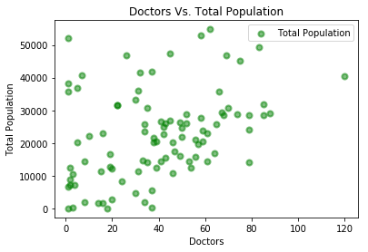
Discussion – Question 1
We did not find a relationship between the income of a zip code and the number of doctors practicing there.

Slide 7
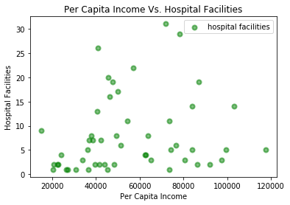
Question #2: Are there more hospitals in lower- or higher-income zip codes?
More hospitals at either the higher or lower end and not as much within areas with medium income per capita
Possibly due to lower property costs

Slide 8
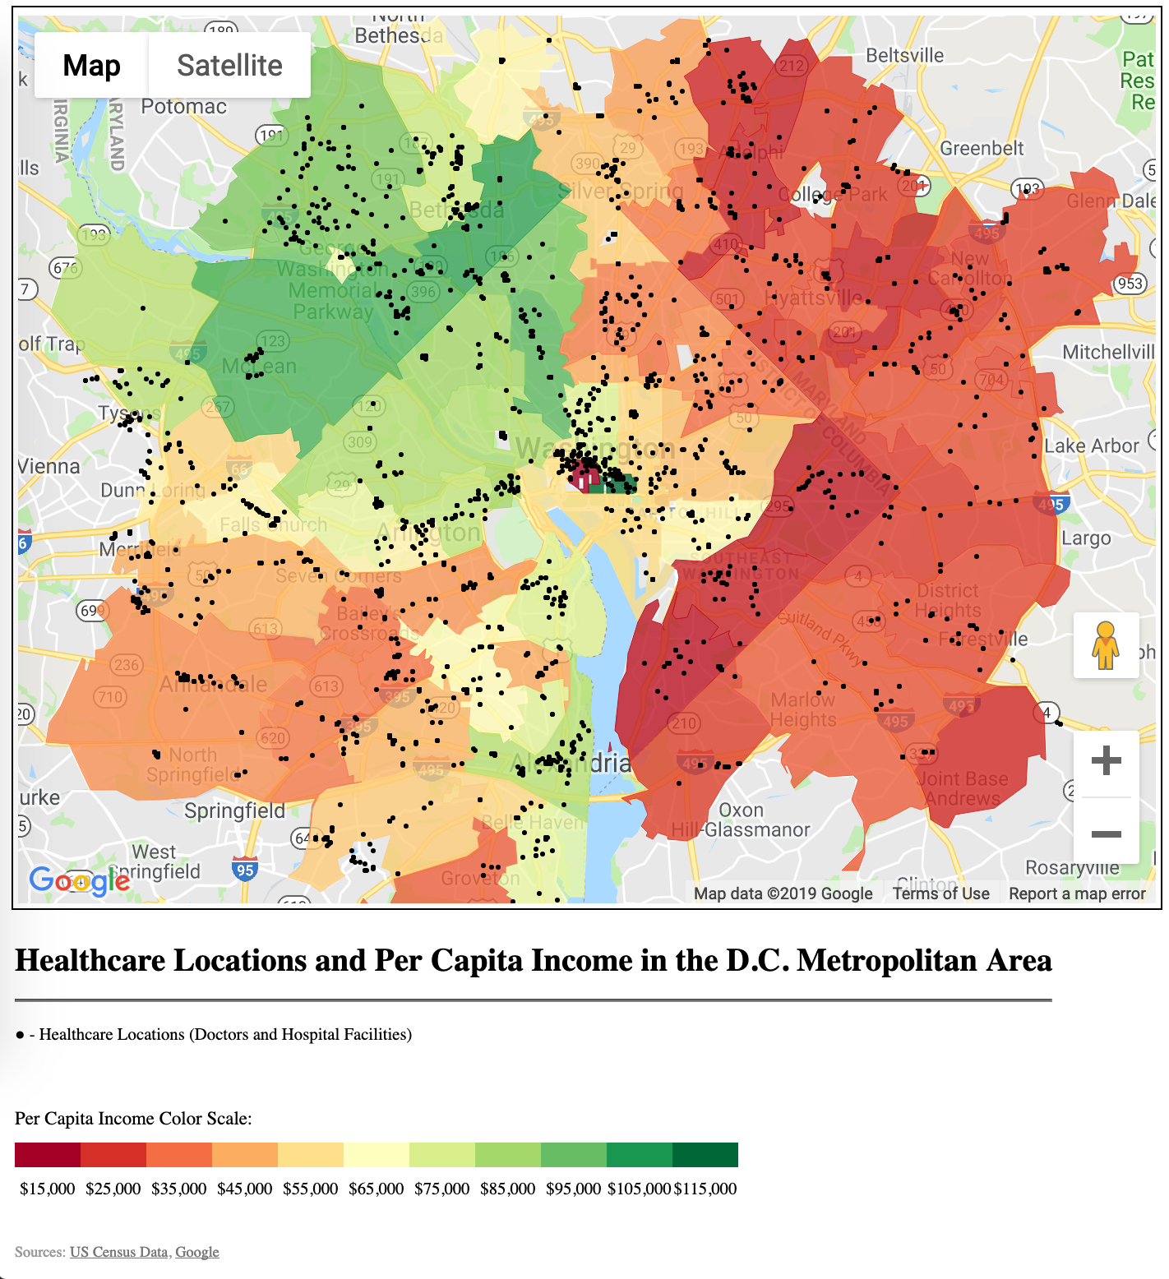
Mapping the data
Among datasets made available by the U.S. Census Bureau were collections of the various tabulation areas. By pairing the Census’ ‘ZIP Code Tabulation Area’ geographic boundaries data with demographic data organized by zip code, we were able to utilize the Google Maps API to render a choropleth map. Geographic coordinates of healthcare providers were retrieved through a Google Places API query. The returned coordinates are fed into the mapping API, allowing us to plot markers for the entire collection of healthcare facilities as an additional visualized layer. At present, Jupyter Gmaps does not natively support creating of map keys or legends. A custom HTML widget was created and rendered inline with the map itself.

Slide 9
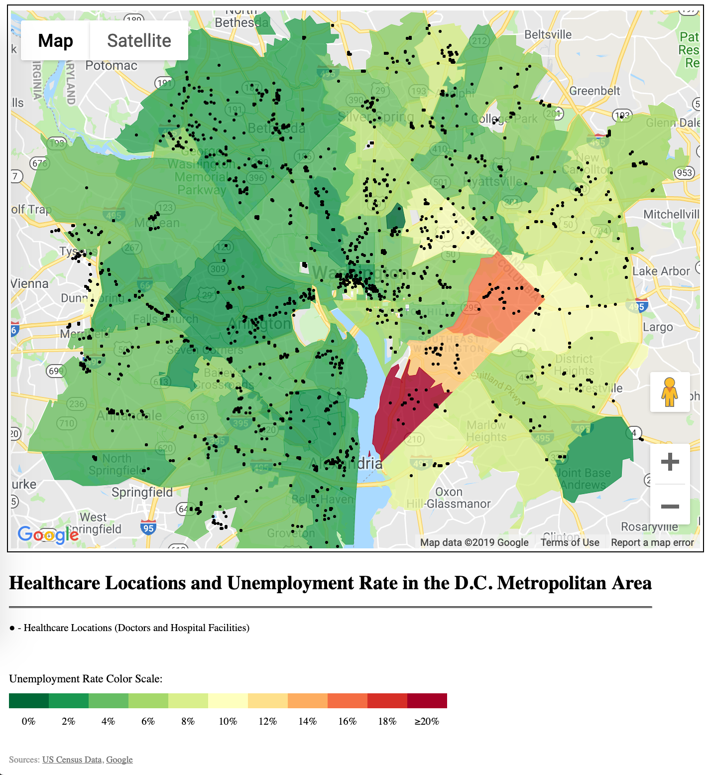
Mapping the data
Among datasets made available by the U.S. Census Bureau were collections of the various tabulation areas. By pairing the Census’ ‘ZIP Code Tabulation Area’ geographic boundaries data with demographic data organized by zip code, we were able to utilize the Google Maps API to render a choropleth map. Geographic coordinates of healthcare providers were retrieved through a Google Places API query. The returned coordinates are fed into the mapping API, allowing us to plot markers for the entire collection of healthcare facilities as an additional visualized layer. At present, Jupyter Gmaps does not natively support creating of map keys or legends. A custom HTML widget was created and rendered inline with the map itself.

Slide 10
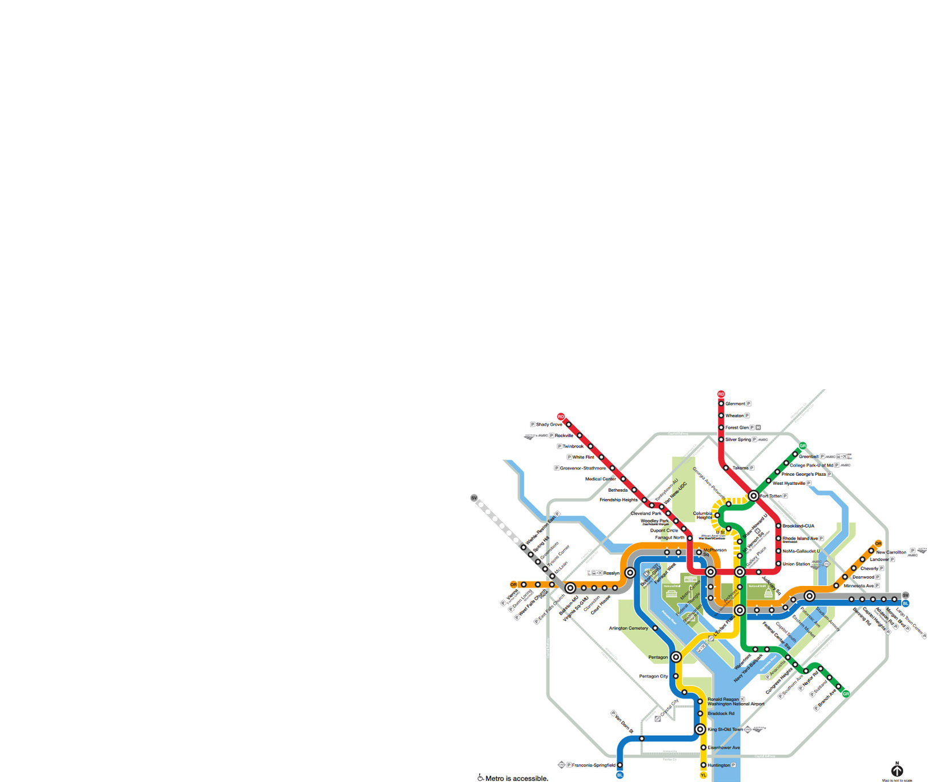
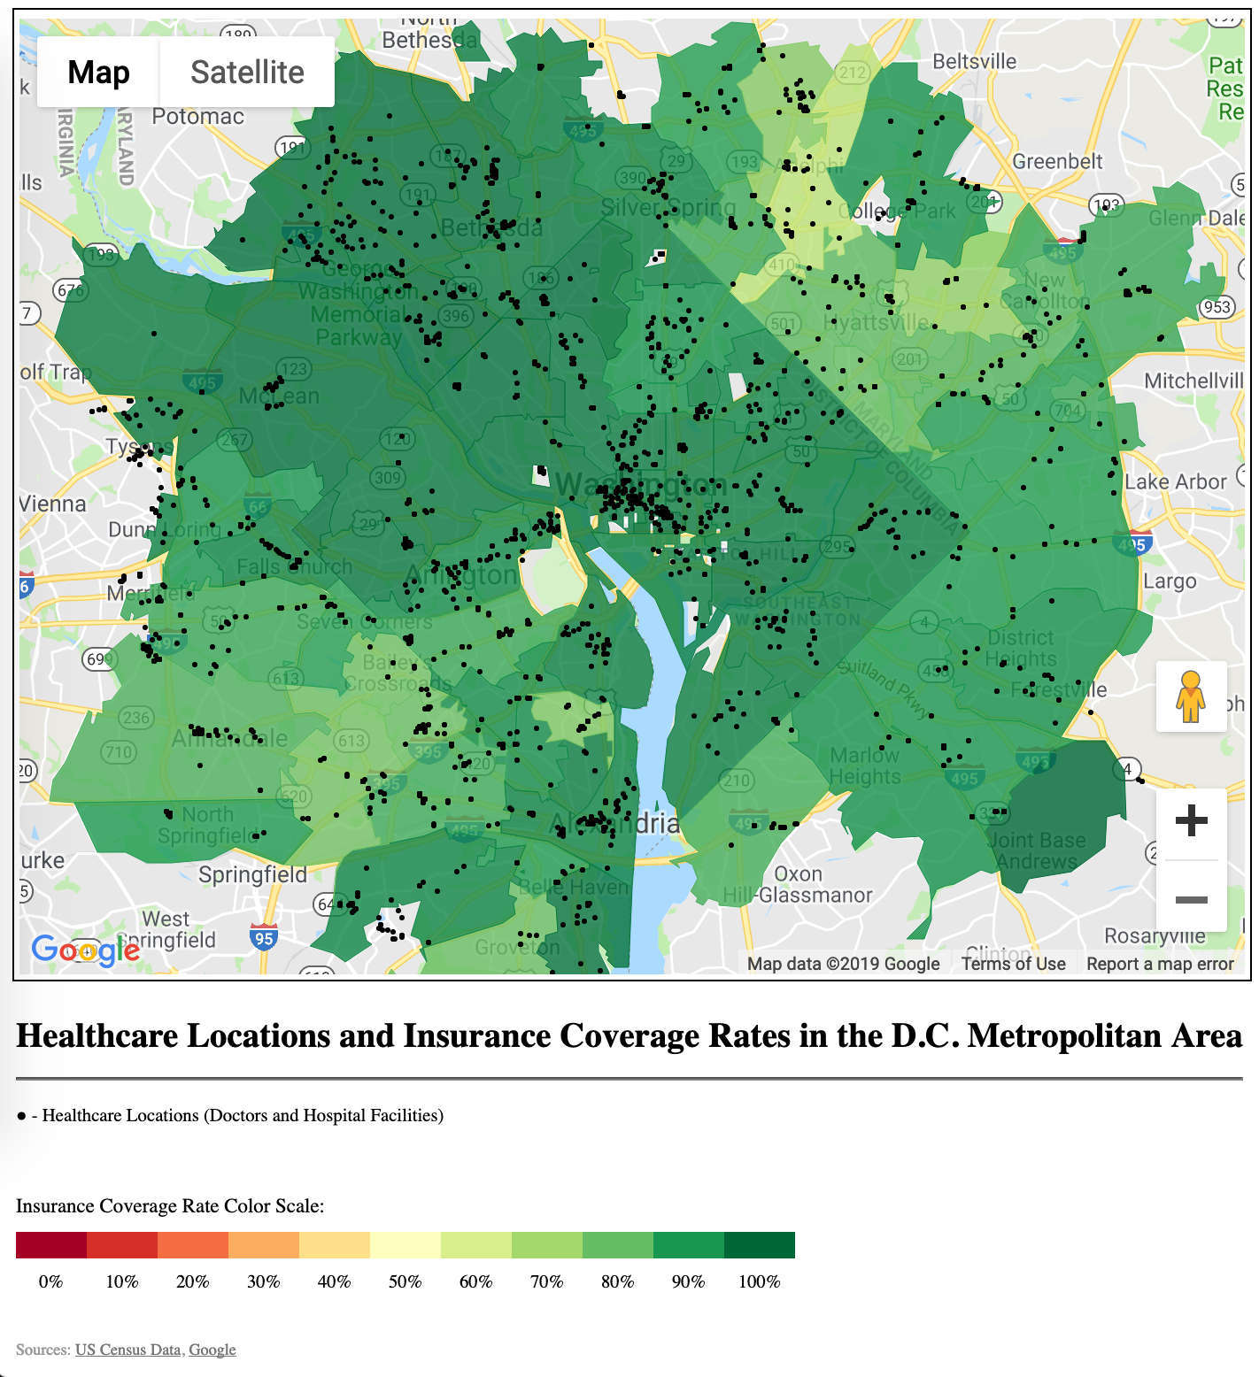
Mapping the data
Among datasets made available by the U.S. Census Bureau were collections of the various tabulation areas. By pairing the Census’ ‘ZIP Code Tabulation Area’ geographic boundaries data with demographic data organized by zip code, we were able to utilize the Google Maps API to render a choropleth map. Geographic coordinates of healthcare providers were retrieved through a Google Places API query. The returned coordinates are fed into the mapping API, allowing us to plot markers for the entire collection of healthcare facilities as an additional visualized layer. At present, Jupyter Gmaps does not natively support creating of map keys or legends. A custom HTML widget was created and rendered inline with the map itself.

Slide 11
Post Mortem

Slide 12
Questions

